Slide 1
Introduction to C

Slide 2
Background
The C programming language was devised by Dennis Ritchie at Bell labs in 1972 (yes, it’s predecessor was B!).
C is a high-level programming language, meaning that it is possible to express several pages of machine code in just a few lines of C code.
Other examples of high-level languages are BASIC, C++, Fortran and Pascal. They are so called because they are closer to human language than machine languages.

Slide 3
Such high-level languages allow a programmer to write programs that are independent of particular types of computer. This is called portability.
Portability can be aided by using an agreed standard when writing your program (such as C99).
A compiler (such as gcc or icc) is used to convert your high-level language program into machine code that can be executed on a computer.
int square(int num) {
HLL
return num * num;
}
push rbp #2.21
mov rbp, rsp #2.21
sub rsp, 16 #2.21
mov DWORD PTR [-16+rbp], edi #2.21 mov eax, DWORD PTR [-16+rbp] #3.18 imul eax, DWORD PTR [-16+rbp] #3.18 leave #3.18
ret #3.18
Assembly
Code
01110000011010001010100100100101001
00011111111111101010111100111001010
10101010011111111111101010100101010
10101010101010101001010101010100101
Machine
Code

Slide 4
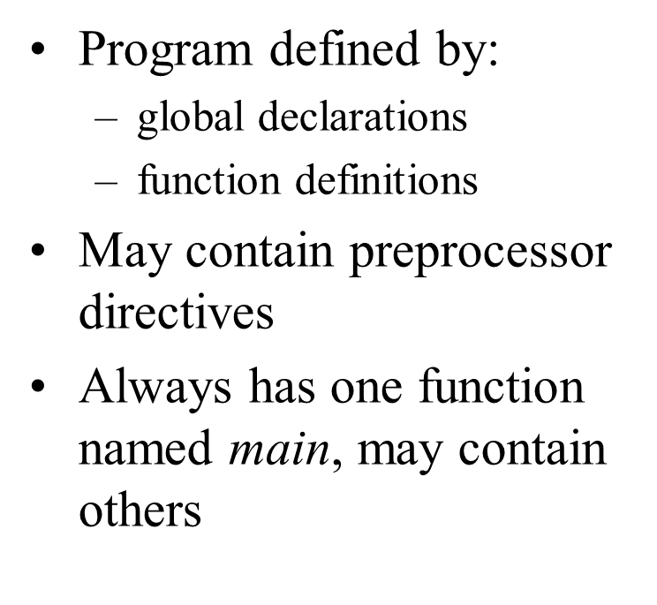
C Program Structure

Slide 5
The components of a C program
#include <stdio.h>
int main() {
return(0);
}
Notes:
The #include directive tells the compiler to include other files stored on your HDD into your C program. These files will include information that does not change between programs that your program can use. On the right we include the standard input and output library.
The main() function is the only component that has to be included in every C program. It is followed by a pair of braces: { }
The return() statement returns values from a function. Within the main() function return()can be used to tell the operating system (in our case Linux) whether our code completed successfully.

Slide 6

Sample Program

Slide 7
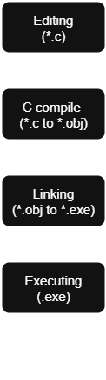
Summary of writing and executing a C program
Editing: Write or modify C source code (saved as .c file)
Compiling: Convert source code into machine instructions (creates .obj file)
Linking: Combine object file with libraries (creates .exe file)
Executing: Run the .exe program

Slide 8
Standard header files
Name | Description
<assert.h> | Contains the assert macro, used to assist with detecting logical errors and other types of bug in debugging versions of a program.
<complex.h> | A set of functions for manipulating complex numbers.
<errno.h> | For testing error codes reported by library functions.
<math.h> | Defines common mathematical functions.
<stdbool.h> | Defines a boolean data type.
<stdio.h> | Defines core input and output functions.
<stdlib.h> | Defines numeric conversion functions, pseudo-random number generation functions, memory allocation, and process control functions.
<string.h> | Defines string handling functions.
<time.h> | Defines date and time handling functions.

Slide 9
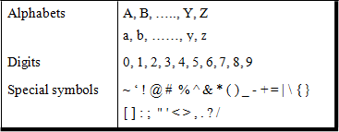
The C Character Set
Character set specifies the valid symbols that can be used in a C program
The C character set consists of the following symbols and escape sequence characters

Slide 10

C Comments
To identify a comment, C uses two different comment formats:
Line Comment
//This is a whole line comment
A=5; //This is a partial line comment
Block Comment
Notes:
Placed by the programmer in the code to help the reader to understand the meaning of sections of code which are not very clear
Comments are merely internal program documentations
Compiler ignores the comments when it translates the program into executable code

Slide 11
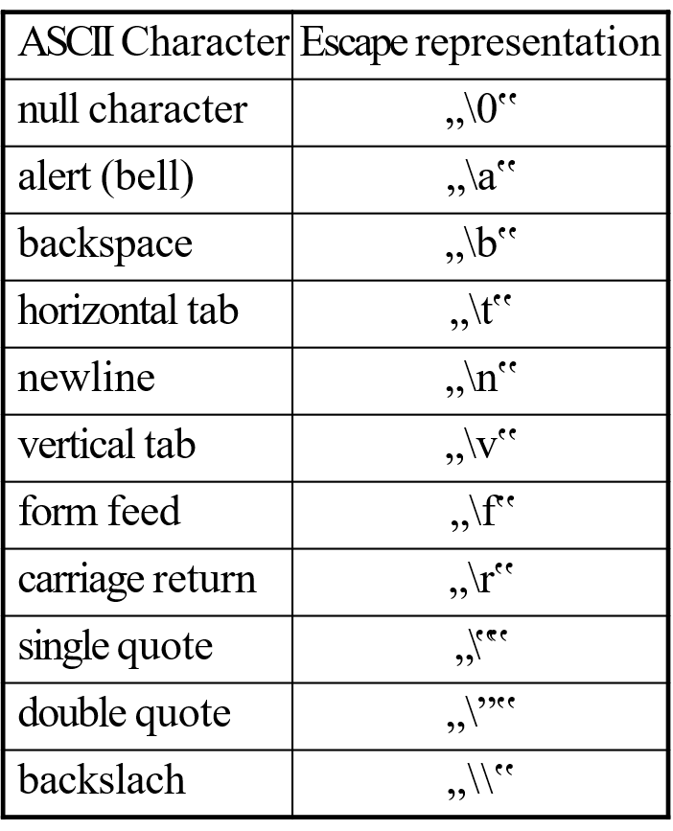
Escape Sequence characters
Notes:
Escape sequence characters are a combination of two characters but treated as a single character.
Often used in printf statements,they are not printed explicitly on the screen but the effect of these characters can be observed.
The table beside shows some ASCII characters and their corresponding escape character format

Slide 12

What is Ubuntu?
Ubuntu is a free, open-source Linux distribution based on Debian.
Widely used for servers, desktops, and cloud environments.
Regular releases with strong community support.

Slide 13
Basic Ubuntu Terminal Commands
pwd (Print Working Directory) - Shows your current location in the file system.
Example: pwdOutput: /home/ubuntu_user/Documents
ls (List Directory Contents - Displays files and folders in the current directory.
Example: ls –l
mkdir [dirname] - Creates a new directory (folder).
rmdir [dirname] - Deletes an empty directory. For non-empty directories, use rm -r,
cp [source] [destination] (Copy) - Copies files or directories from one location to another.
mv [source] [destination] (Move/Rename) - Moves files or directories, or renames them within the same location.

Slide 14
C Program Development Workflow
Write the Code :
Use gedit to create your C source file. A basic "Hello, World!" program looks like this:
gedit hello.c
#include <stdio.h>
int main() {
printf("Hello, Ubuntu!\n");
return 0;}
2. Compile with GCC :
The gcc compiler transforms your C code into an executable program. Use -o to name the output.
gcc hello.c -o hello
3. Run the Program
Execute your compiled program directly from the terminal. The ./ denotes the current directory.
./hello
Notes:
It's a simple, intuitive text editor for Ubuntu.

Slide 15
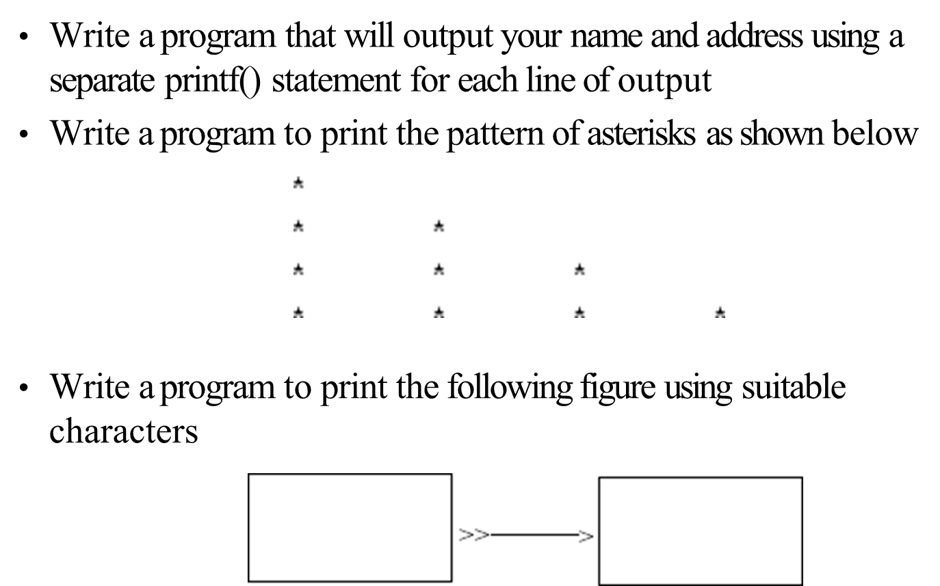
Exercises

Slide 16
Identifiers
C identifiers represent the name in the C program, for example, variables, functions, arrays, structures, unions, labels, etc.
// Creating a variable
int val = 10;
// Creating a function
void func() {}
Notes:
In C programming, identifiers are the names used to identify variables, functions, arrays, structures, or any other user-defined items. It is a name that uniquely identifies a program element and can be used to refer to it later in the program.

Slide 17
Rules for Identifiers in C
The only valid alphabets to be used for naming are upper case letters from A to Z and lower case letters from a to z
_ (underscore) is the only special symbol that can be used in an identifier
Numeric symbols from 0 to 9 can be used but the first symbol of an identifier cannot be a numeric symbol
The first symbol of an identifier must be an alphabet or an underscore
Typically application programs do not use underscore as the first symbol because many of the identifiers in C system libraries start with an underscore
Duplication of system names for identifiers could be confusing
Last but not the least, C has 32 keywords also known as

Slide 18
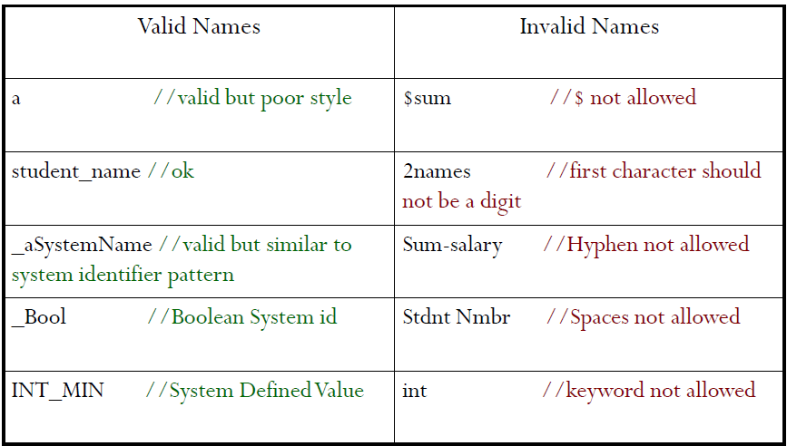
Examples of Valid and Invalid Identifier Names

Slide 19
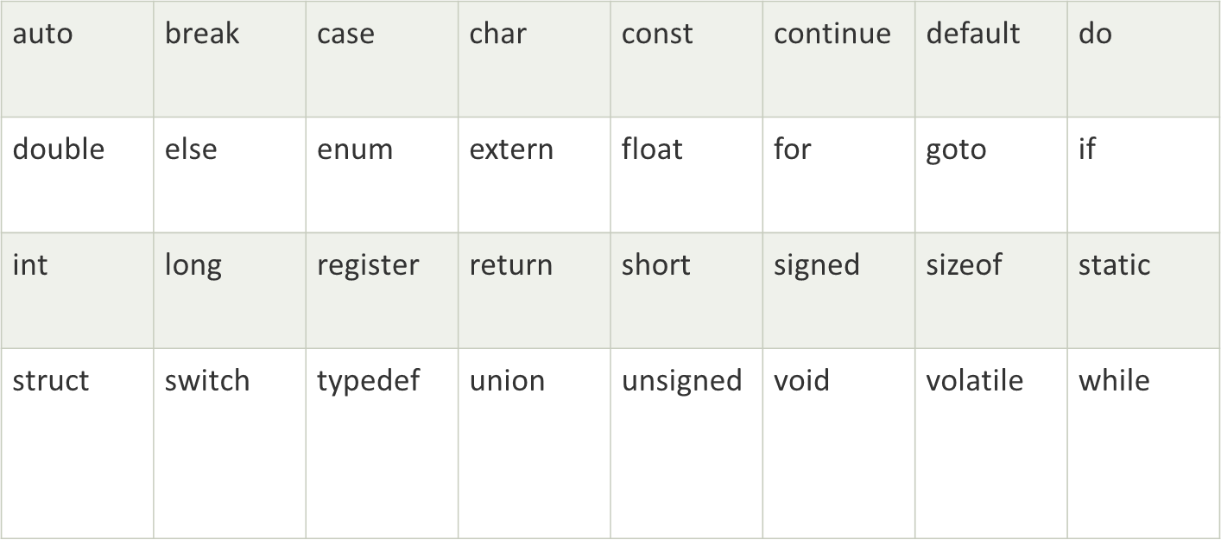
Keywords in C
A list of 32 keywords in the c language is given below:
Notes:
Keywords in C are reserved words that have predefined meanings and cannot be used as identifiers (e.g., variable names, function names). They are fundamental to the structure and functionality of C programs.

Slide 20
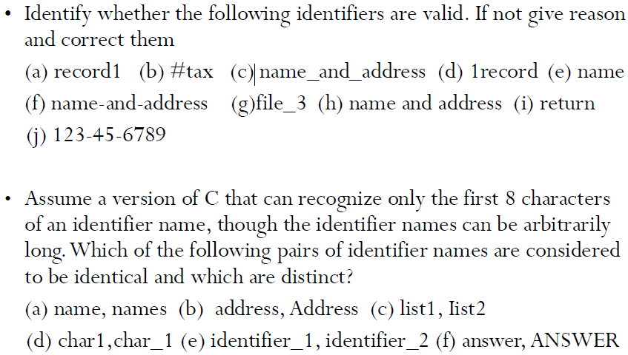
Exercises:
Notes:
(a)record1 -valid(b) #tax -invalid (#character not allowed)
(c) name_and_address -valid(d) 1record –invalid –first character cannot be a number(e) name –valid(f) name-and-address –invalid (hyphen not allowed)(g)file_3 -valid(h) name and address -invalid (spaces not allowed)(i) return –invalid (keyword)(j) 123-45-6789 –invalid (contains all numbers)
(a) name, names -distinct(b) address, Address -distinct(c) list1, Iist2 –distinct (d) char1,char_1 -distinct(e) identifier_1, identifier_2 -identical (f) answer, ANSWER -distinct

Slide 21
Types in C
A type defines a set of values and a set of operations that can be applied on those values
For example a light switch can be compared to a type
It can have two values on and off
Only two operations can be applied to the light switch: turn on and turn off
The defined set of types in C can be divided into four general categories: void, integral, floating-point and derived
Notes:
In C programming, "types" primarily refer to data types, which classify the kind of values a variable can hold and the operations that can be performed on them.

Slide 22
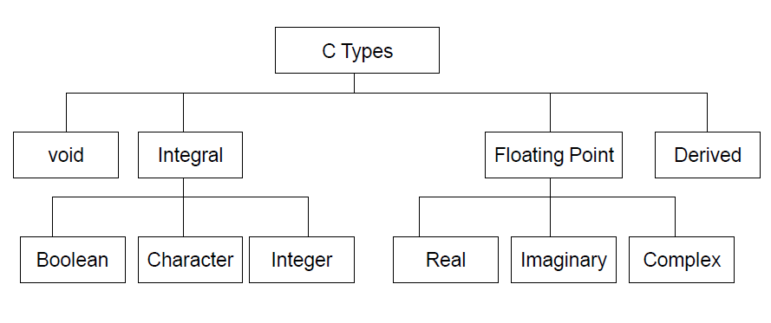
Notes:
Void type:
•Is designated by the key word void
•Has no values and no operations
•Very useful type
•Used in cases where a function has no parameters or return values and for many other purposes which will be covered in the forthcoming topics
•Integral type:
•Integral types cannot contain fractional parts i.e., they can contain only whole number quantities
•C Language has three kinds of integral types: Boolean, Character and Integer
•Boolean:
•Can represent only two values: true or false
•Is referred to by the key word bool
•Boolean type is stored in the memory as 0 or 1
•Character:
•A character data type holds any single symbol from the C character set
•Is referred to by the key word char
•The size of a character is 1 byte or 8 bits
•Integer:
•Is a number without a fraction part (whole numbers)
•C supports four different sizes of integer data types: short int, int, long int and long long int
•C defines these data types so that they can be organized from smallest to largest

Slide 23
Data Type | Keyword | Bytes | Range | Usage (example)
Character | char | 1 | −128 to 127 | char c = 'A’; printf("char c = %c\n", c);
Short integer | short | 2 | −32 767 to 32 767 | short s = -12345; printf("short s = %d\n", s);
Integer | int | 4 | −2 147 483 647 to 2 147 483 647 | int count = 1000; printf("int count = %d\n", count);
Long integer | long | 4 | −2 147 483 647 to 2 147 483 647 | long l = 100000L; printf("long l = %ld\n", l);
Unsigned character | unsigned char | 1 | 0 to 255 | unsigned char uc = 200; printf("unsigned char uc = %u\n", uc);
Unsigned short integer | unsigned short | 2 | 0 to 65 535 | unsigned short us = 60000; printf("unsigned short us = %u\n", us);
Unsigned integer | unsigned int | 4 | 0 to 4 294 967 295 | unsigned int ui = 3000000000U; printf("unsigned int ui = %u\n", ui);
Unsigned long integer | unsigned long | 4 | 0 to 4 294 967 295 | unsigned long ul = 4000000000UL; printf("unsigned long ul = %lu\n", ul);
Single-precision floating-point | float | 4 | 1.2 E⁻³⁸ to 3.4 E³⁸ | float f = 3.14f; printf("float f = %f\n", f);
Double-precision floating-point | double | 8 | 2.2 E⁻³⁰⁸ to 1.8 E³⁰⁸ | double d = 3.1415926535; printf("double d = %lf\n", d);
Notes:
The “Range” column in that table simply tells you the minimum and maximum values that each C type can hold on a typical implementation

Slide 24
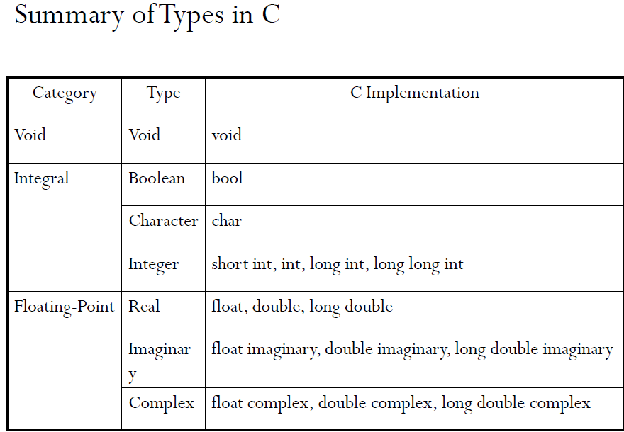

Slide 25
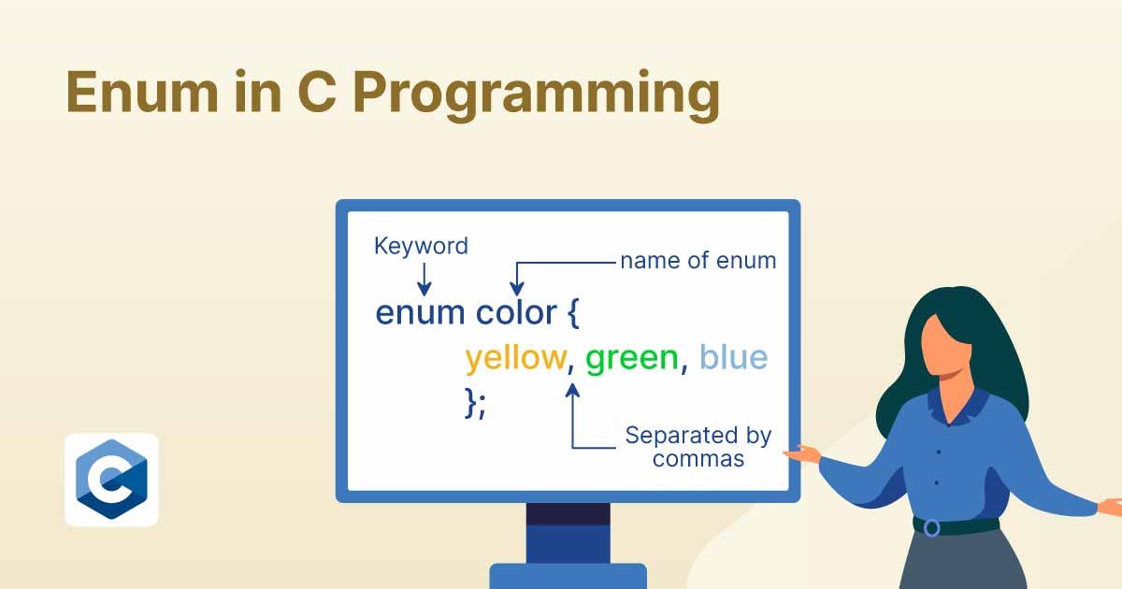
Notes:
An enum in C is simply a way to define a new integral type whose values are a fixed set of named constants. Although it feels like a “fifth” category, it really lives under the integral types umbrella.

Slide 26
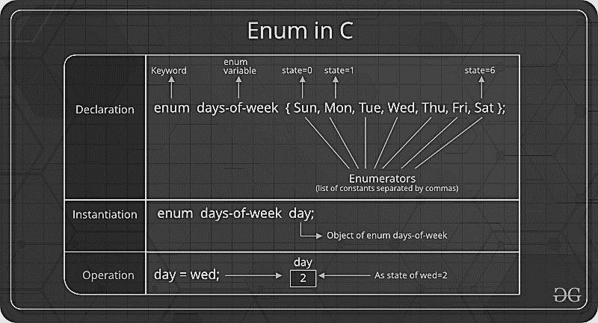
Enumeration (or enum) is a user defined data type in C. It is mainly used to assign names to integral constants, the names make a program easy to read and maintain. enum State {Working = 1, Failed = 0};

Slide 27
// An example program to demonstrate working
// of enum in C
#include<stdio.h>
enum week{Mon, Tue, Wed, Thur, Fri, Sat, Sun};
int main()
{
enum week day;
day = Wed;
printf("%d",day);
return 0;
}
Notes:
Output: 2
In the above example, we declared “day” as the variable and the value of “Wed” is allocated to day, which is 2. So as a result, 2 is printed. Another example of enumeration is

Slide 28
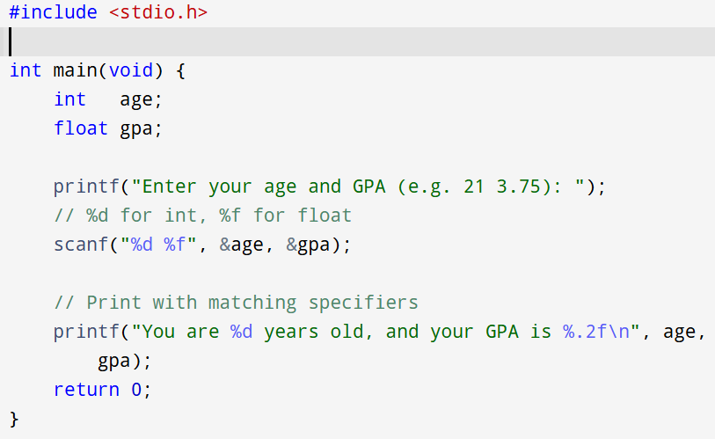
Example 1: Integers & Floats
Notes:
%d reads/writes an int.
%f reads/writes a float.
The & before variable names passes their address to scanf.

Slide 29
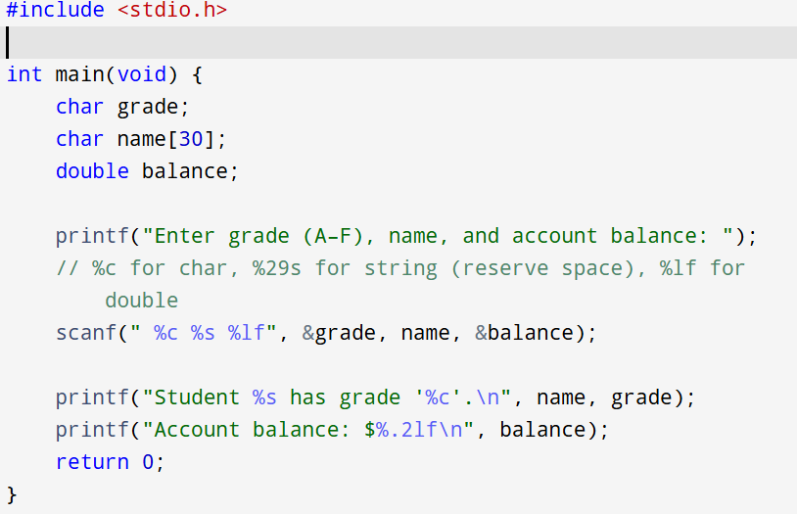
Example 2:
Notes:
%c reads/writes a single char.
%s reads/writes a null-terminated string; here %29s prevents overflow of the 30-byte buffer.
%lf reads/writes a double.
Note the leading space in " %c" skips any leftover newline or whitespace before reading the character.

Slide 30
Exercise question
Write a C program to print the size (in bytes) of char, short, int, long, float and double using the sizeof operator.
Write a C program that prompts the user for an integer and a float, then prints both values and their sum (as a float).
Write a C program that sets an unsigned int to UINT_MAX, increments it by 1, and prints the value before and after to demonstrate wrap-around overflow.
Write a C program that reads a single character from the user, then prints the character and its ASCII code.
Write a C program that reads two integers, then prints:
a. The result of integer division.
b. The result of floating-point division by casting one operand to float.
Notes:
unsigned int x = UINT_MAX;
printf("Before increment: x = %u\n", x);
x++; // wraps around from UINT_MAX to 0
printf("After increment: x = %u\n", x);
Before increment: x = 4294967295After increment: x = 0

Slide 32
Variables and Constants
The C language has different numeric data types that you can use in your program depending on what type of number you need to store or manipulate.
This is useful for many reasons. For example if our program only operates on small numbers
(-128 to 127) then we can use a char which
takes up a single byte of memory rather than using a long integer that might take 4 bytes or 8 bytes of memory space.
Along with this we might want to work on decimal numbers. In C, real numbers are stored as floating point variables, these have a fractional part. Integers are stored as integer numbers and have no fractional part.
Variables with more bytes require more computational operations to manipulate them, so this will slow down program execution.

